Slide 1

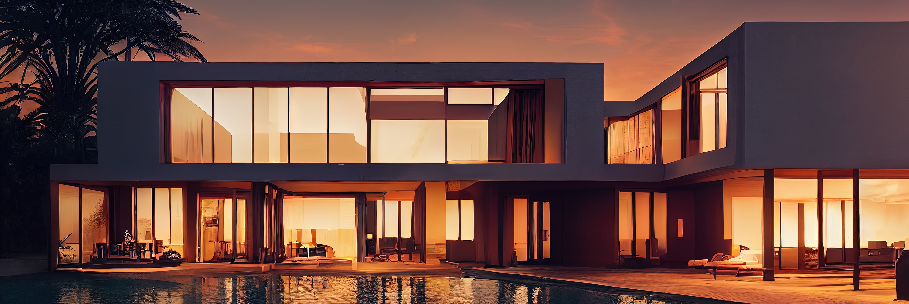
PROJECT
RENTAL PRO
NAME : EEMAAN FATIMA , NIMRA TANVEER
REG NO : 23-NTU-CS1146,1201

Slide 2
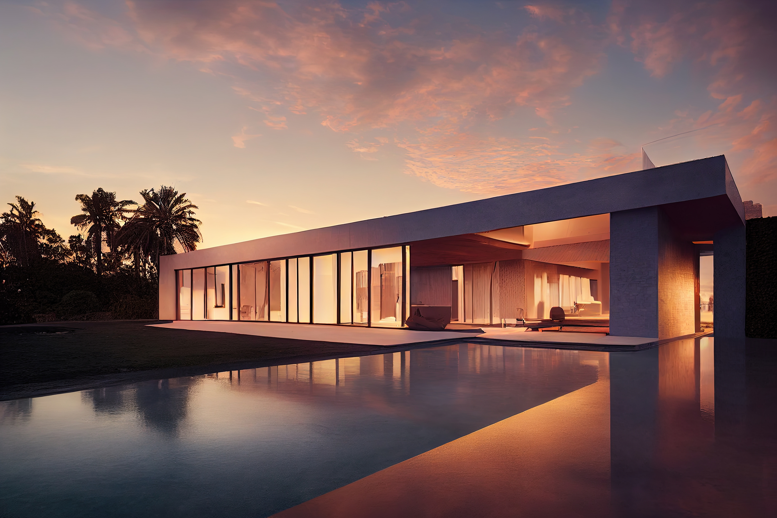
Arowwai Industries
Problem Statement
•Traditional property rental methods are slow and inefficient
•Users rely on newspapers, dealers, and social media
•No centralized management system available
•Communication between renters and landlords is difficult

Slide 3
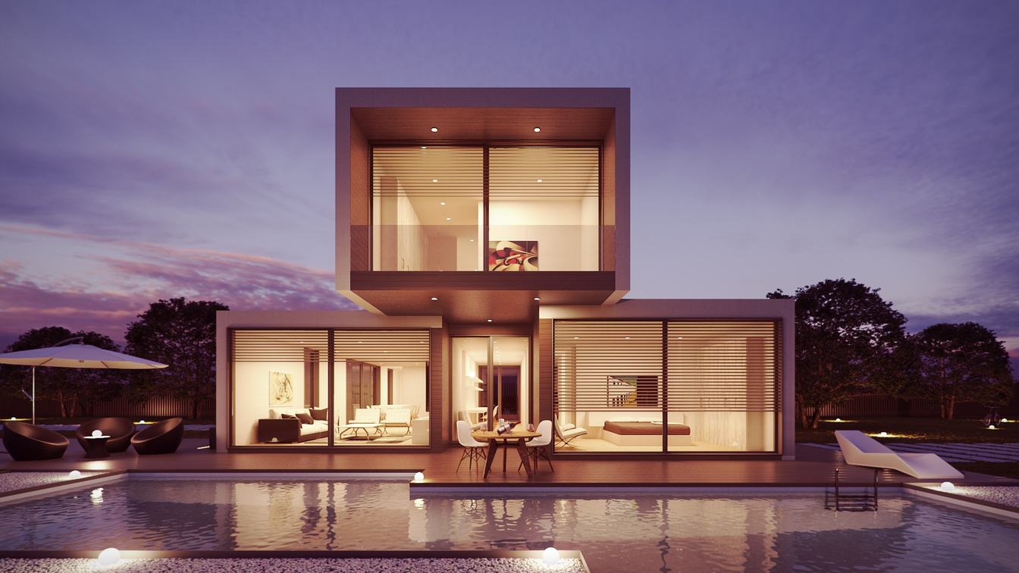
Objectives
•Develop a mobile-based rental application
•Simplify property searching process
•Provide secure property management
•Improve communication between renters and landlords
•Implement smart search and filtering

Slide 4


Literature Review
•Existing systems include Zameen, Graana, and Airbnb
•Most systems are commercial and complex
•Digital rental systems improve accessibility
•Map integration improves user experience

Slide 5

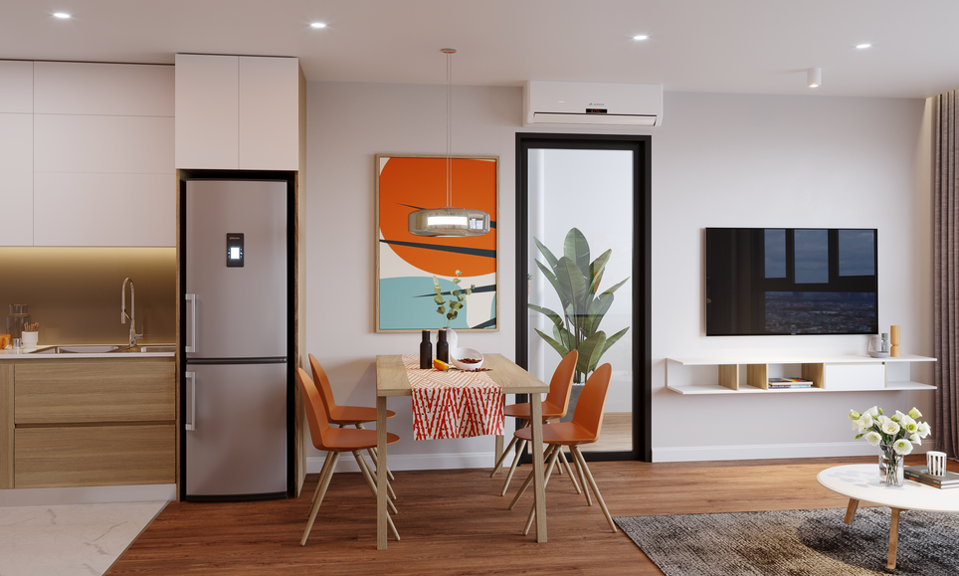
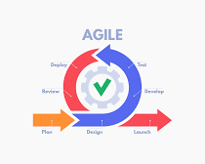
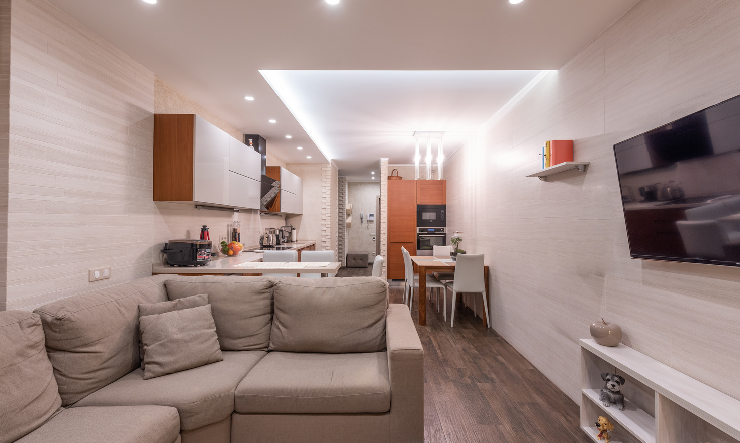
Methodology Used (Agile Model)
•Requirement Gathering
•System Design
•Development and Testing
•Feedback and Improvements
•Deployment and Maintenance

Slide 6

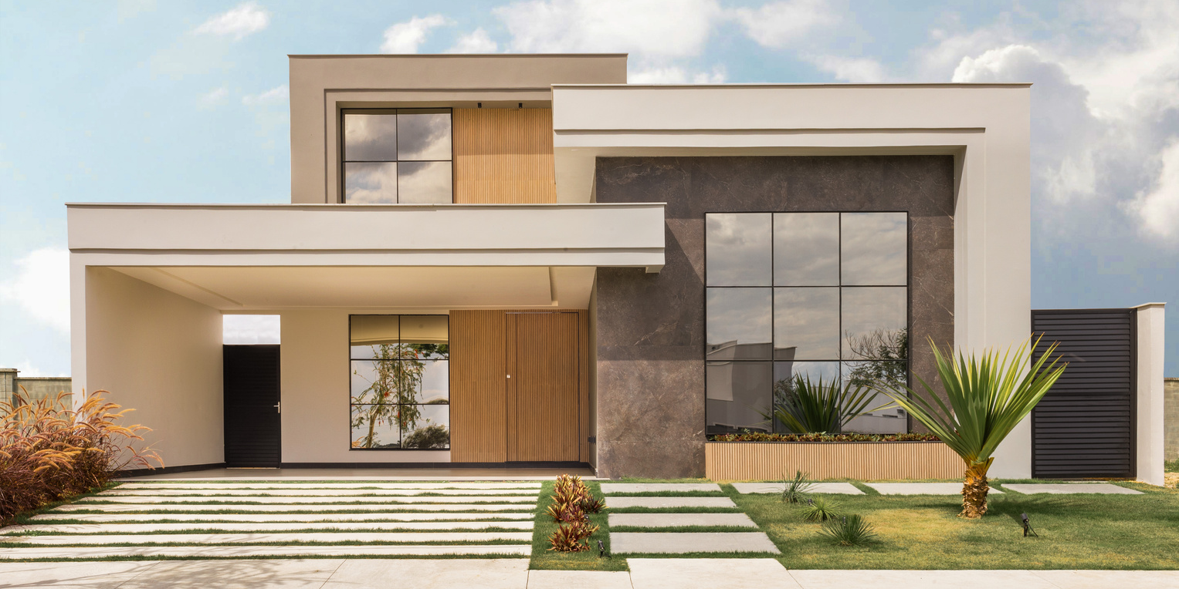
Scope
•User Authentication Module
•Property Search Module
•Property Management Module
•Property Details Module
•Google Maps Integration
•Modern UI/UX Design

Slide 7


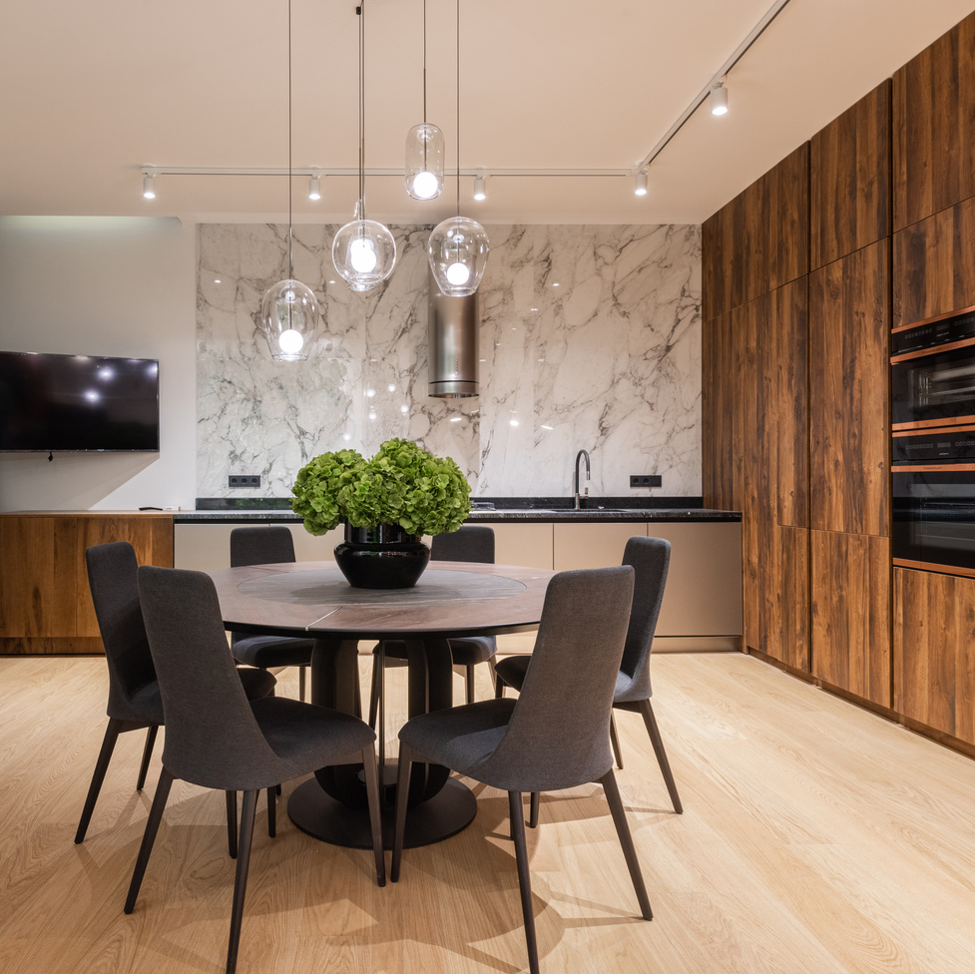
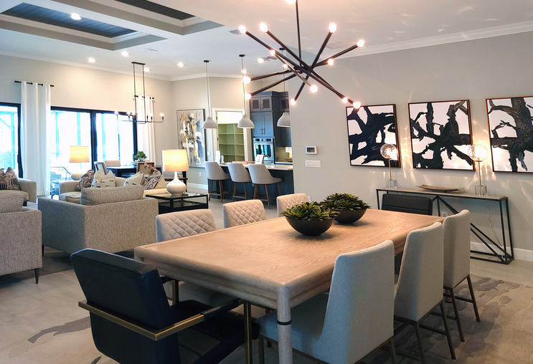
Functional Requirements
•User Signup/Login
•Property Uploading and Management
•Property Search and Filtering
•Google Maps Integration
•Direct Contact with Landlords

Slide 8
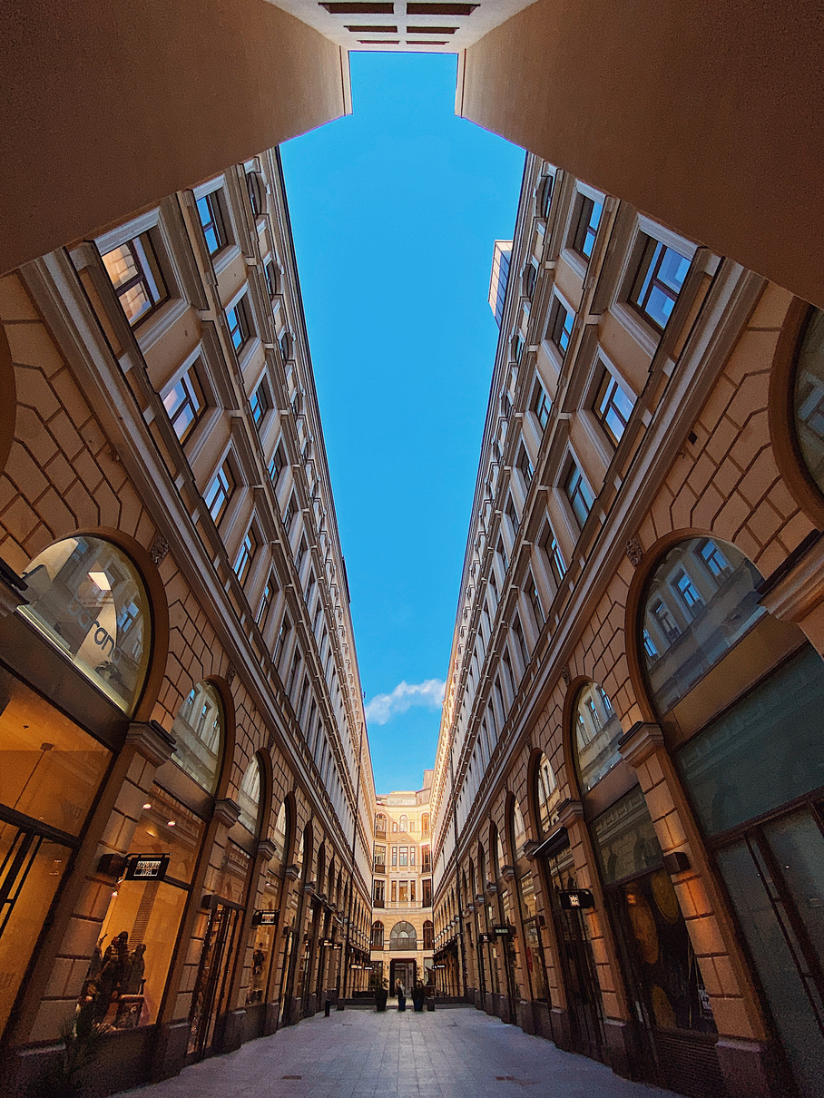
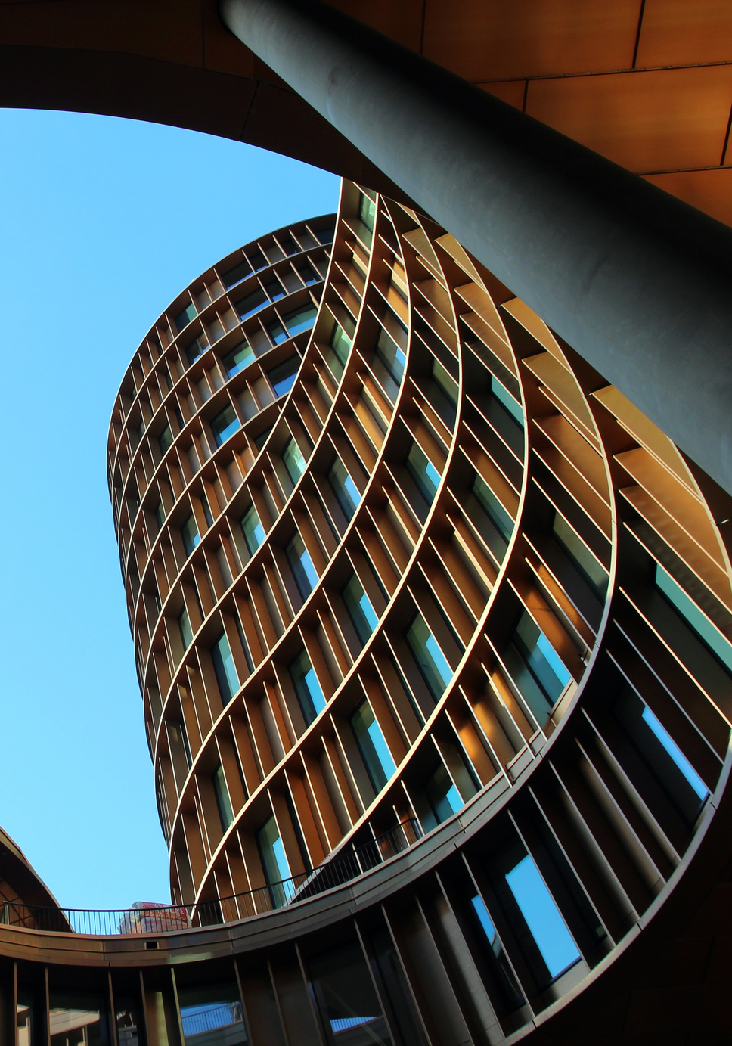
Non - Functional Requirements
•High Performance
•Secure Authentication
•User-Friendly Interface
•Reliable and Scalable System
•Fast Response Time

Slide 9
Technologies Used
•Flutter Framework
•Dart Programming Language
•Firebase Authentication
•Cloud Firestore Database
•Google Maps API

Slide 10
Arowwai Industries
Future Enchancement
•User-friendly rental platform developed
•Easy property management and searching
•Future features: AI recommendations
•Online payment integration
•Push notifications and in-app chat

Slide 11
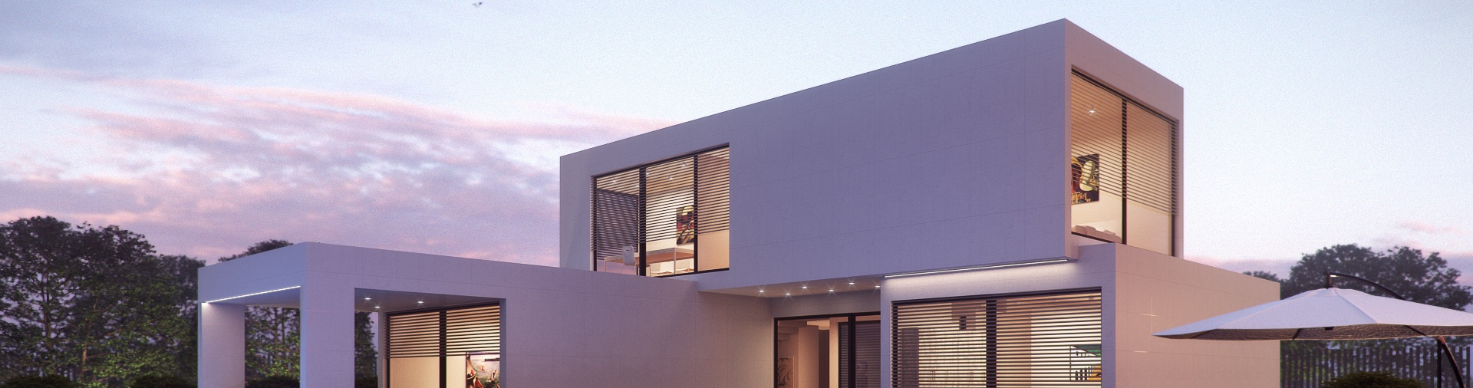
THANK YOU

